Slide 1
Building A Code Generator For Novel Programming
Submitted by:
P.NAGA SAI RUTHWIK (192211733)
L.KONDAREDDY (192210009)
P.MURALIDHAR REDDY (192211961)

Slide 2

Introduction to Code Generation for Novel Programming
Novel programming combines novel-writing and coding.
Code generators automate the process of creating code from Novel scripts.
Building a code generator for Novel programming can streamline the development process.
Programming
Notes:
Image source: https://www.youtube.com/watch?v=cbNljGlusDU

Slide 3
Problem Statement:
Design and implement a code generator for a novel programming language, addressing the challenges associated with creating a system that can efficiently translate high-level, domain-specific language constructs into executable code. The goal is to empower developers with a tool that streamlines the development process, allowing them to express complex ideas using a unique syntax while ensuring the generated code is optimized for performance and maintainability.

Slide 4
Understanding Novel Programming
Novel programming involves using natural language elements to write code.
Novel scripts are converted into executable code by the code generator.
Novel programming allows for a more intuitive and expressive way of writing code.
Notes:
Image source: https://www.linkedin.com/pulse/nlp-rijika-roy-4f

Slide 5
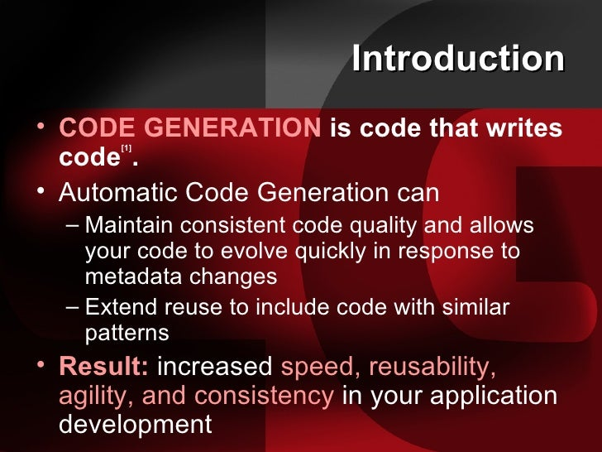
Benefits of Code Generation for Novel Programming
Code generators reduce the time and effort required to write code.
Novel programmers can focus on the creative aspects of coding rather than syntax.
Code generators help maintain consistency and reduce errors in the codebase.
Notes:
Image source: https://www.slideshare.net/adorepump/automatic-code-generation

Slide 6
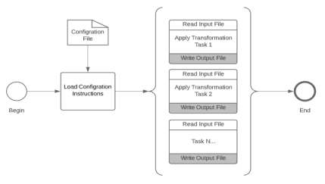

Slide 7
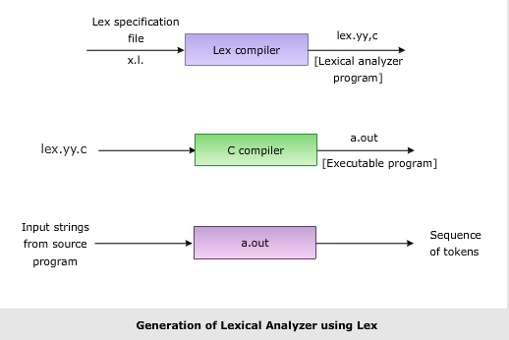
Components of a Code Generator for Novel Programming
Lexical analysis: Breaking down Novel scripts into tokens.
Syntax analysis: Parsing the tokens to create a syntax tree.
Code generation: Generating executable code from the syntax tree.
Notes:
Image source: https://estudies4you.blogspot.com/2017/07/designing-of-lexical-analyzer.html

Slide 8
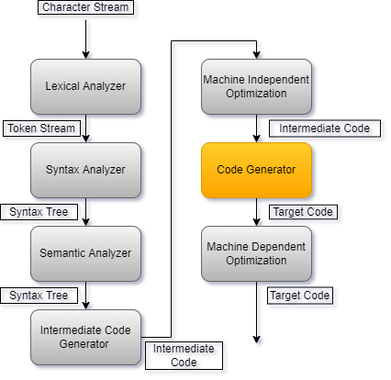
Design Considerations for a Code Generator
Support for various programming languages and platforms.
Error handling to provide meaningful feedback to Novel programmers.
Extensibility to accommodate future enhancements and new features.
Notes:
Image source: https://iq.opengenus.org/code-generation-in-compiler-design/

Slide 9
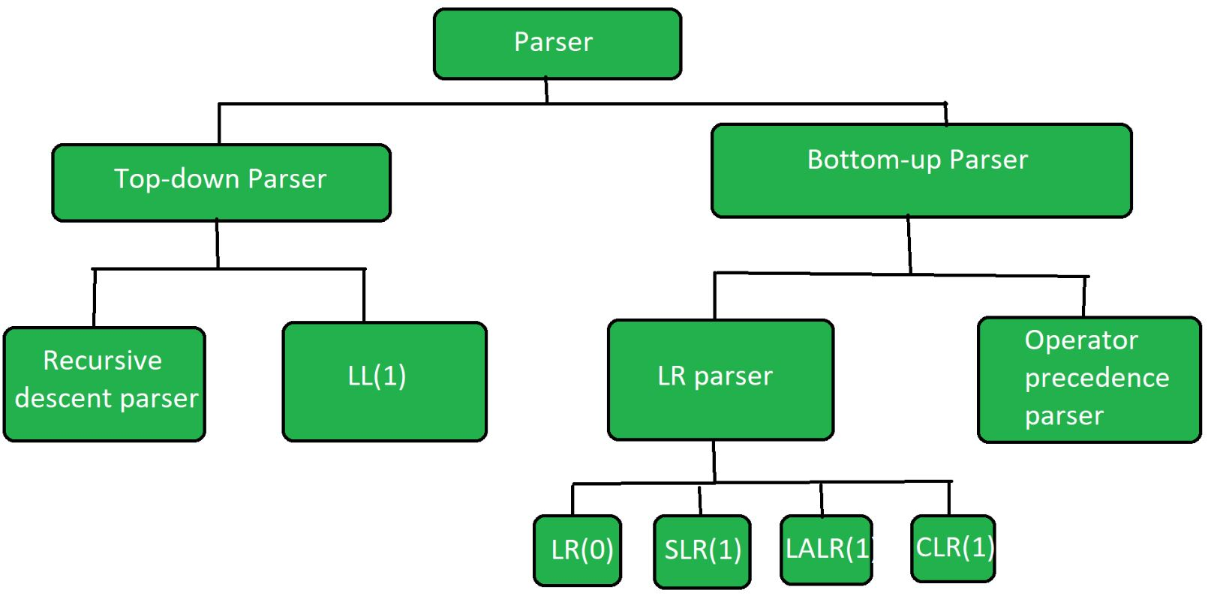
Implementing a Code Generator for Novel Programming
Choose a suitable programming language for the code generator.
Develop parsers and generators based on the Novel language specifications.
Test the code generator with a variety of Novel scripts to ensure accuracy and efficiency.
Notes:
Image source: https://hailieghopmiddleton.blogspot.com/2022/04/explain-difference-between-bottom-up.html

Slide 10
Challenges in Building a Code Generator for Novel Programming
Balancing flexibility and constraints in the Novel language.
Handling ambiguity and natural language variations in Novel scripts.
Ensuring scalability and performance of the code generator for large-scale projects.
Notes:
Image source: https://www.slideshare.net/ijreteditor/a-novel-load-balancing-model-for-overloaded-cloud

Slide 11
Best Practices for Code Generation in Novel Programming
Documenting the Novel language syntax and semantics for reference.
Using automated testing and validation techniques to verify the generated code.
Collaborating with Novel programmers to gather feedback and improve the code generator.
Notes:
Image source: https://www.thinkful.com/blog/coding-best-practices/

Slide 12
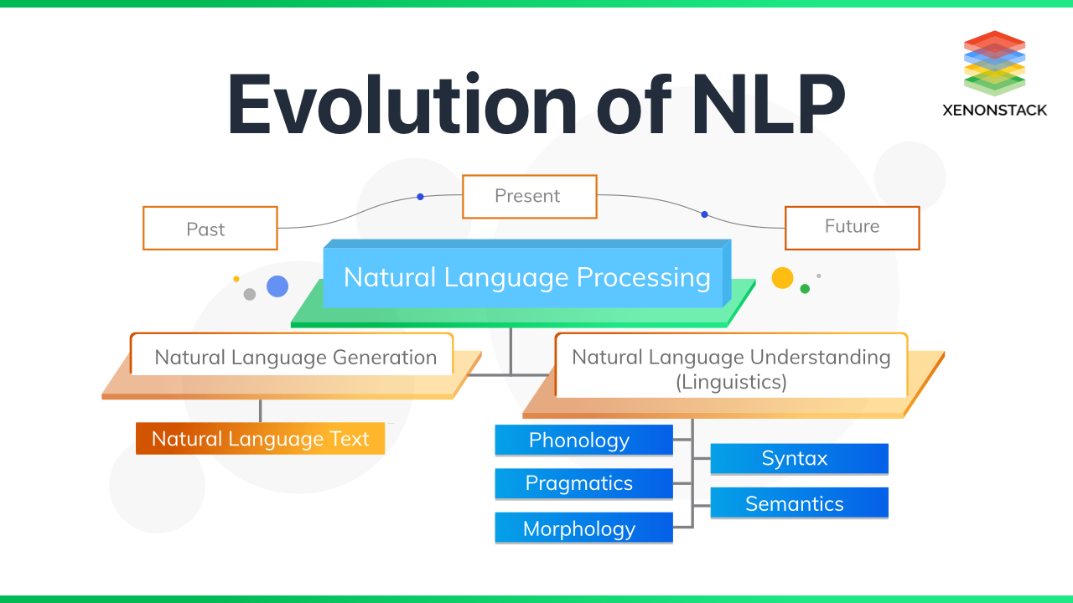
Future Trends in Novel Programming and Code Generation
Integration of AI and machine learning techniques for smarter code generation.
Adoption of domain-specific languages tailored for Novel programming.
Continued research and development to enhance the efficiency and usability of code generators.
Notes:
Image source: https://www.peppercontent.io/blog/tracing-the-evolution-of-nlp/

Slide 13
Conclusion
Building a code generator for Novel programming can revolutionize the way code is written.
Code generators enable Novel programmers to focus on creativity and innovation.
Embracing code generation in Novel programming can lead to faster development cycles and higher-quality software.
Notes:
Image source: https://justtiffme.com/5-data-structures-for-effective-programming/

